Slide 1

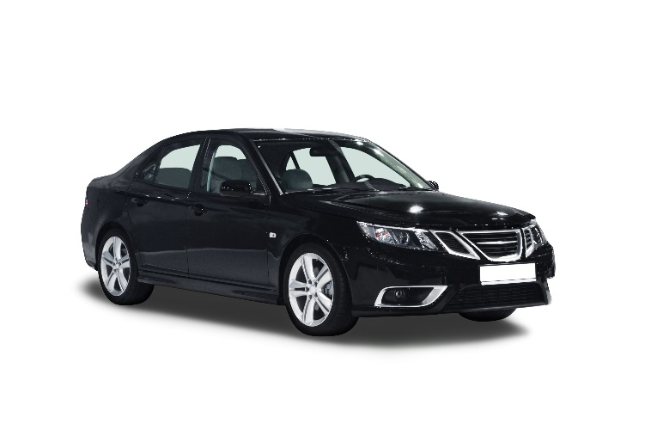
Penn Liberty Motors
Corporate Sponsor
Philadelphia International Auto Show
Contact Us

Slide 2
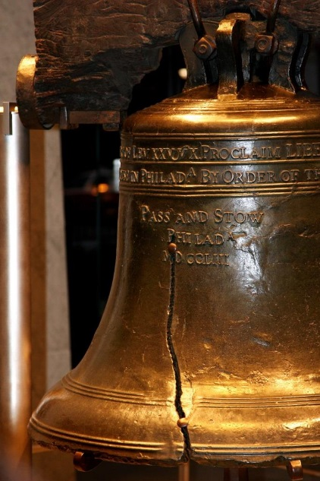
Location
Pennsylvania Convention Center
Located in the heart of Philadelphia

Slide 3
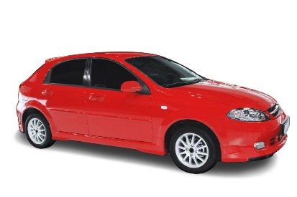
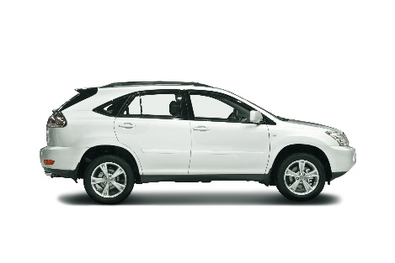
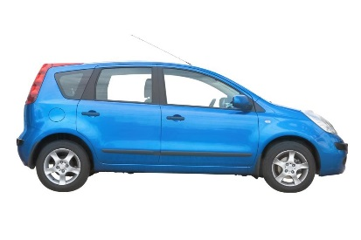
Annual Auto Show
4 Convention Center Halls
550,000 Square Feet
700 Vehicles
40 Manufactures

Slide 4
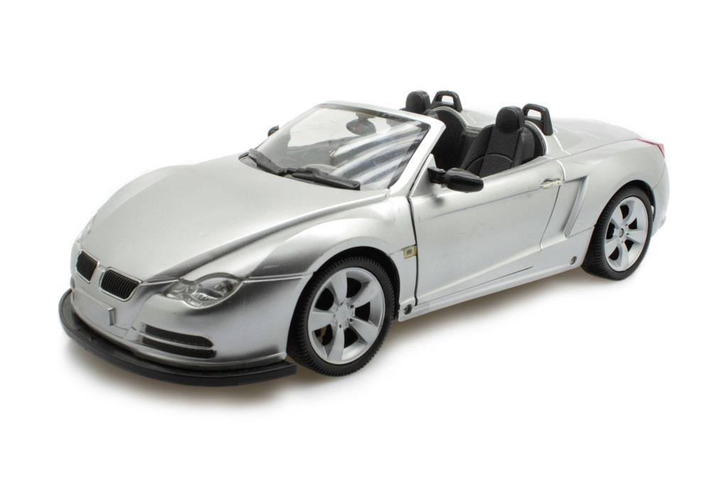
Activities
Black Tie Gala
Exhibitors
Workshops
Seminars

Slide 5
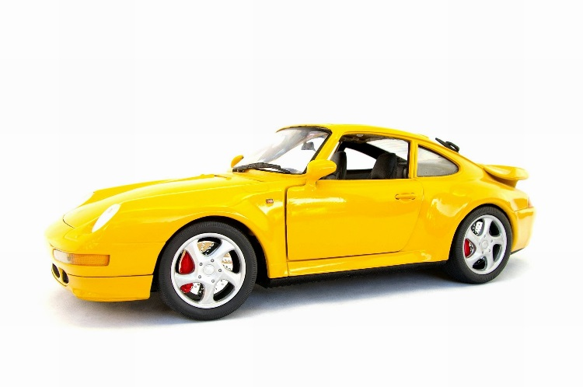
Special Event - Consumer Education Seminar
“Best Fit” Lifestyle Vehicles
Research a Vehicle
Test Drive Importance
Buy vs Lease

Slide 6
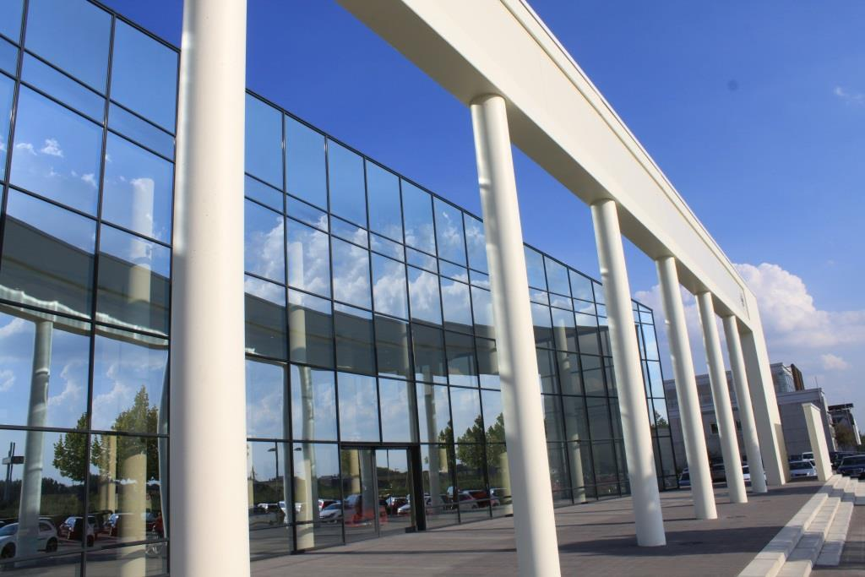
Expansion Information
1 million square feet of space
Host large trade shows
Host 2 major conventions simultaneously

Slide 7

Philadelphia Convention Center
Exhibit Halls
Meeting Rooms
Banquet Rooms
Public Circulation Space

Slide 8
Amenities
Cutting Edge Technology
Wireless Access
Impressive Art Collection

